Slide 1
CS487-Introduction to competitive programming: A2SV
Lecture #13 Graph Traversal (DFS, BFS)

Slide 2
Graph Representation
We already covered what a graph is
2 common ways to represent
Adjacency matrix
Adjacency list

Slide 3
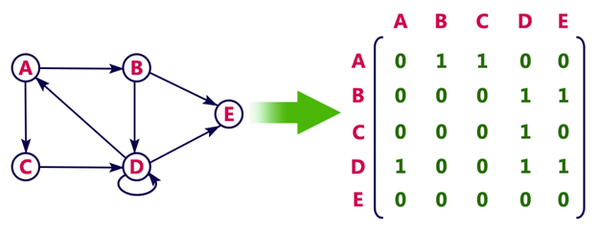
Adjacency Matrix
Checking existence of an edge: O(1)
Required memory: O(N^2)
Better for dense graphs
Iterating over neighbors of a node: O(N)

Slide 4
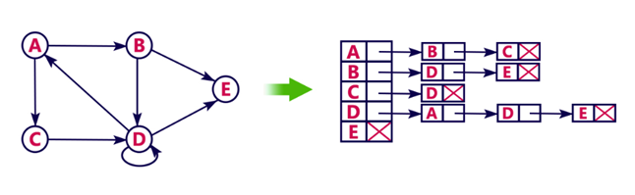
Adjacency List
Efficient for sparse graphs
Checking existence of an edge is slow: O(k), where k is the # of neighbors
Iterating over neighbors of a node is fast: O(k), where k is the # of neighbors

Slide 5
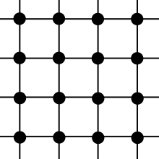
Grids as Graphs
Grids(2D arrays) can be thought as graphs
Adjacency is usually defined either 4 directions or 8 directions
Using neighbor finder array is super useful
For 4 directions; neighbors = {{0, 1}, {1, 0}, {-1, 0}, {0, -1}}
For 8 directions; neighbors = {{0, 1}, {1,1}, {1, 0}, {1, -1}, {0, -1}, {-1, -1}, {-1, 0}, {-1, 1}}
The logic is easy to expand to 3D

Slide 6
Depth First Search(DFS)
Go as long as you can find an unvisited node
void dfs(Node node) {
visited[node.id] = true;
for(Node child : node.children) {
if(!visited[child.id]) {
dfs(child);
}
}
}
Total traversal takes O(N + M), where N is the # of nodes, M is the number of edges

Slide 7
Breadth First Search(BFS)
Visit nodes level by level
void bfs(Node node) {
queue<Node> que;
que.insert(node);
Visit[node.id] = true;
while(!que.isEmpty()) {
Node curr = que.front();
que.pop();
for(Node child : curr.children) {
if(!visited[child.id]) {
que.push(child);
visited[child.id] = true;
}
}
}
}
Total traversal takes O(N + M), where N is the # of nodes, M is the number of edges
Animation: https://visualgo.net/en/dfsbfs

Slide 8
Programming Exercises
Link
Link
Link
Link
Link
Link
Link
Link
Link
Link
Link
Link
Link
Link
Link
Link
Link
Link
Link
Link
Link
Link
Link
Link
Link
Link
Link
Link
Link

Slide 9
Quote of the day
“Do not expect everything from the government.”

